Slide 1
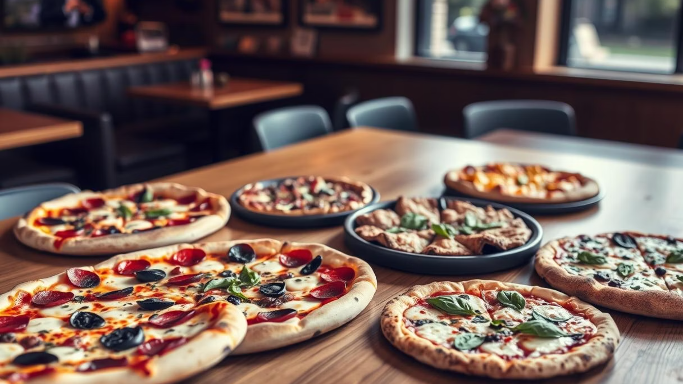
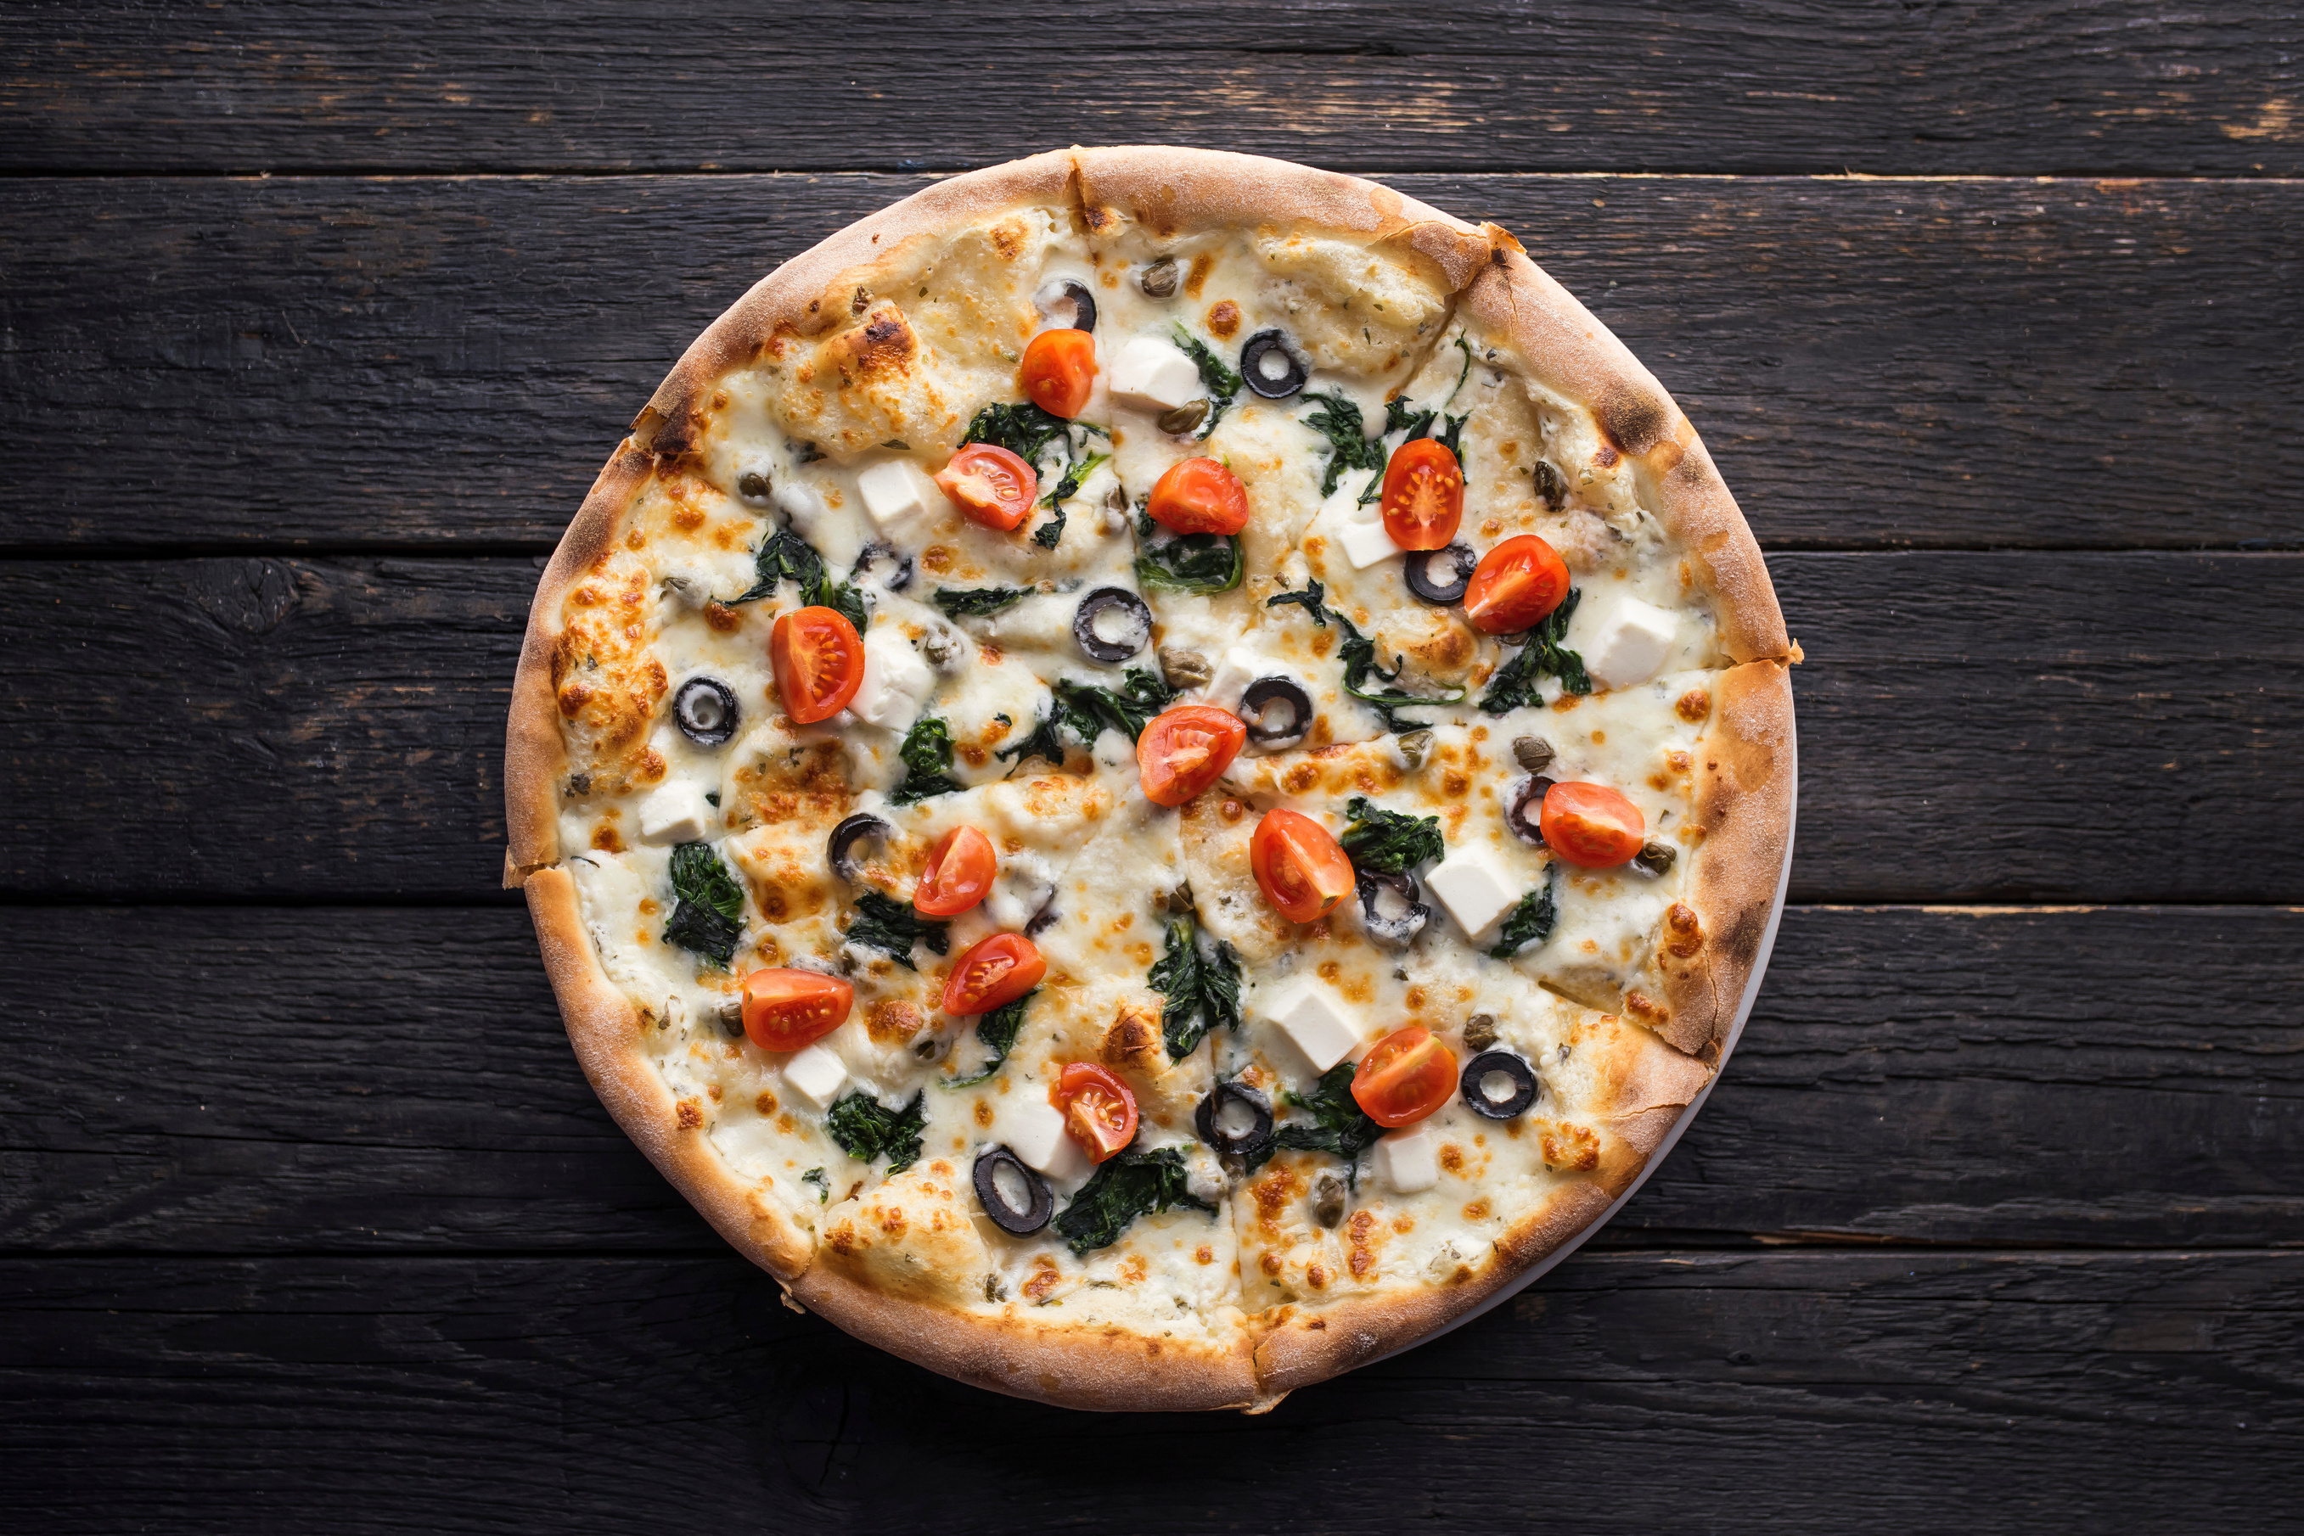

Pizza Restaurant: Sales Summary
Notes:
1

Slide 2

Total Orders Placed
21350
Orders Placed
As of today, a total of 21,350 pizza orders have been served.
Notes:
2

Slide 3

Total Revenue from Pizza Sales
Total revenue from pizzas sales reached $817860, reflecting strong customer demand and menu popularity.
Note: This figure excludes taxes and delivery fees to focus purely on pizza sales.
Notes:
3

Slide 4
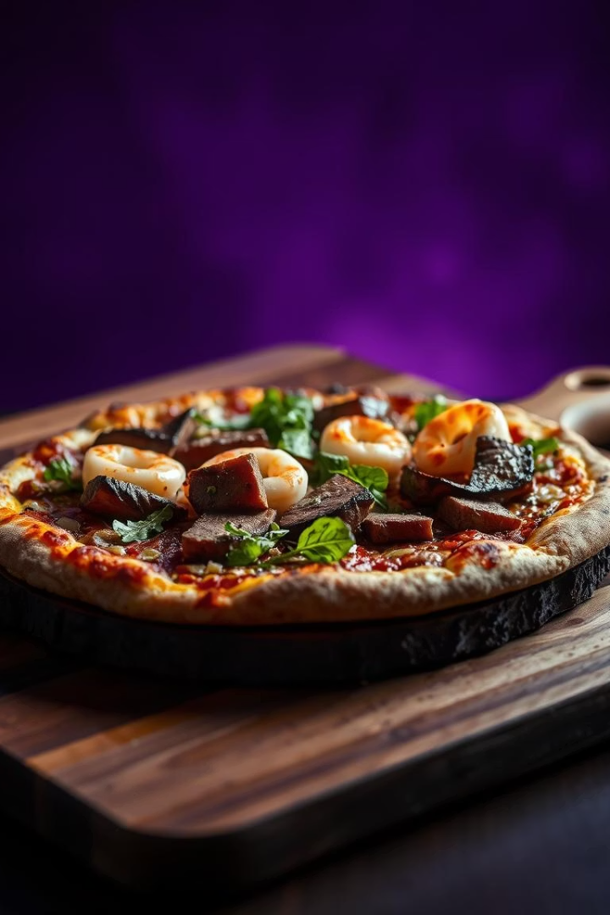
Highest-Priced Pizza
The Greek Pizza
Top-priced pizza at $35.95, loaded with premium meats and specialty cheeses for a savory feast.
Notes:
4

Slide 5
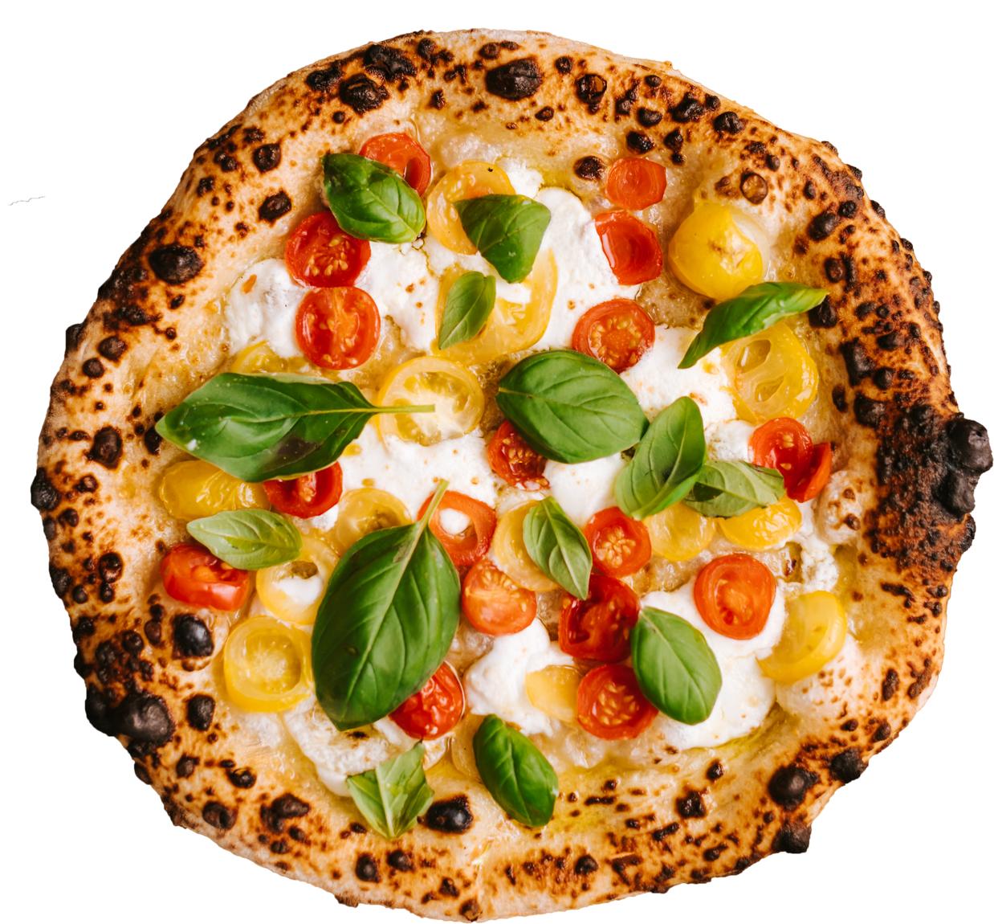
Most Common Pizza Size
Size: Large
Purchased 18526 times, making it the most popular choice among customers.
Notes:
5

Slide 6
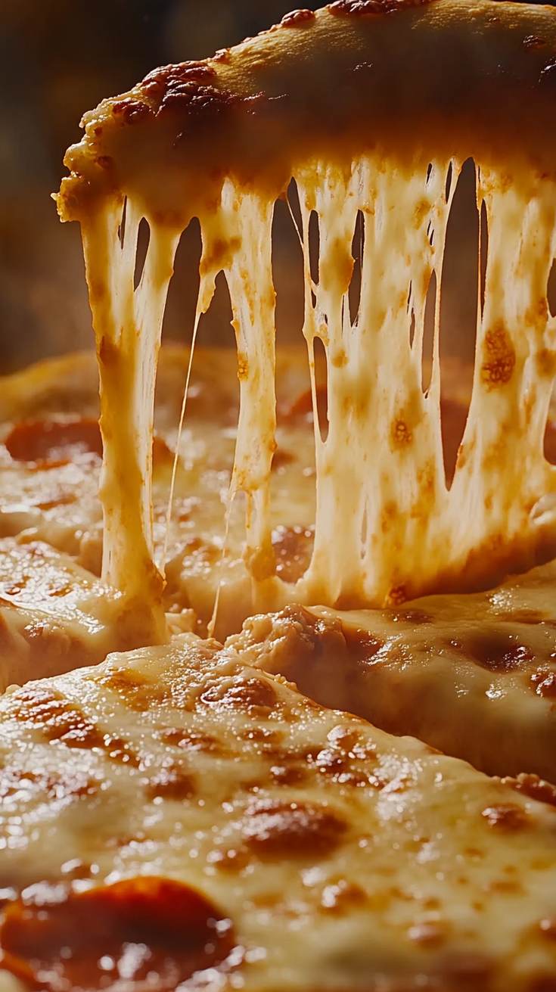
Top 5 Most Ordered Pizza Types
The Classic Deluxe Pizza: 2,453 orders
The Barbecue Chicken Pizza: 2,432 orders
The Hawaiian Pizza: 2,422 orders
The Pepperoni Pizza: 2,418 orders
The Thai Chicken Pizza: 2,371orders
Notes:
6

Slide 7


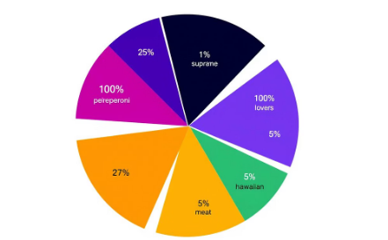
Data Sources and Methodology
Data Integration
Combining orders, products, and time data from restaurant databases.
Hourly Order Distribution
Analyzed orders by hour to identify peak sales periods.
Category Insights
Joined data tables to map orders to specific pizza categories.
Notes:
7

Slide 8
Revenue and Order Insights by Pizza Type
Each top pizza type contributes significantly to total revenue, reflecting customer preference.
Cumulative revenue grows steadily with orders over time, indicating sales consistency.
The top 3 pizzas by revenue in each category reveal targeted menu strengths.
The Thai Chicken Pizza: 43,434.25 Revenue
The Barbecue Chicken Pizza: 42,768 Revenue
The California Chicken Pizza: 41,409.5 Revenue
Notes:
8

Slide 9


Data Sources and Methodology
Data was gathered from the restaurant’s order management system and sales database.
Pizza sales were tracked through transaction records, ensuring comprehensive sales figures and popularity metrics.
Analysis covers all orders placed in the past 12 months for accuracy and trend insights.
Notes:
10

Slide 10



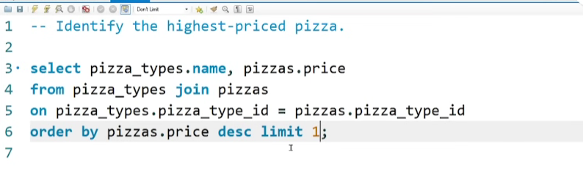


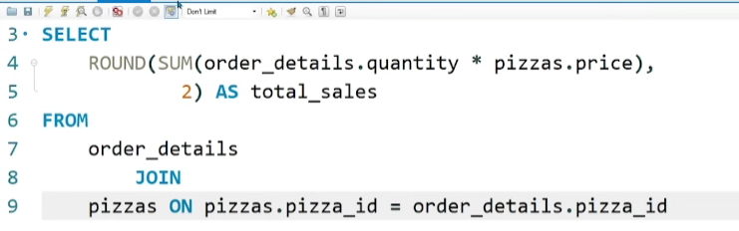
TOTAL ORDERS
Top 5 Most ordered pizza’s types
Most expensive Pizza
Most ordered pizza’s size
Top 3 Pizza’s
Total Revenue

